Slide 1

Welcome to Reception
Kingfishers
Mrs Devereux
Robins
Miss Simpson
Teaching Assistants
Miss Fanczo, Mrs Hooper and Mrs Rochester

Slide 2
Meet the staff
Mrs J Scutt – Executive Headteacher
Mrs S Wilson – Head of School
Mrs L Willison – Deputy Headteacher
Miss J Titterington - SENDCo
Mrs S Talbot – Pastoral Lead
Mrs A-M Devereux – Kingfishers Class Teacher
Miss A Simpson – Robins Class Teacher

Slide 3
What does the average day look like?
8:40 – School gates open
8:45 – Classroom doors open
8:55 – School gates close – if you arrive after this time, please go to the office to sign in
9:00 – Morning movements and Phonics
9:30 – Continuous Provision, learning through play
11:30 – Singing and Story
11:45 – Lunchtime
1:00 – Register and maths
1:30 – Continuous Provision, learning through play
2:45 – Tidy, Story and collect things for home
3:15 – parents collect from playground

Slide 4
Curriculum
Details about the curriculum for each subject can be found on the school website.
This year, the enquiry topics for Reception will be:
Term 1 | Term 2 | Term 3 | Term 4 | Term 5 | Term 6
What makes me special | Colours | Homes | The enchanted forest | Minibeasts | Paws, claws and whiskers

Slide 5
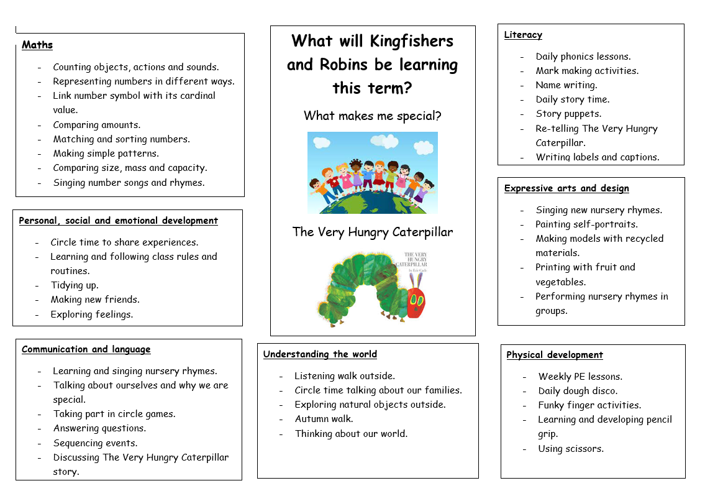
Autumn term 1 topic web

Slide 6
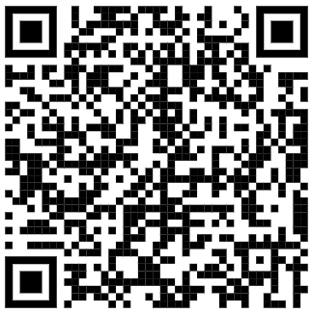
Phonics
At Watchfield we follow the Read Write Inc Phonics programme.
How can you help your child at home?
Talk, talk, talk!
Read to and with your child
Sing!
Pronounce words and sounds clearly
Model blending
Scan to find out more about phonics, have access to free resources and discover how to support you and your child at home.
Notes:
1. Talk, talk, talk!
As a parent, you are the model of good speaking and listening. Regularly introduce new words (vocabulary). For example, for the word big you could also introduce large, huge, or enormous. Encourage them to say the word too. This is not about reading the words but about your child hearing and saying them.
2. Read to and with your child
This models good reading skills and promotes reading enjoyment. Have a special book box or bag where your child can keep the stories and any other texts, such as comics or non-fiction books, you’ve read together recently. Re-read these so that over time your child builds up their stock of stories and texts they know well.
3. Sing!
Teach nursery rhymes and songs and make lots of opportunities to sing and recite them.
4. Pronounce words and sounds clearly
In all games and activities make sure you pronounce the speech sounds clearly and as short as possible. Do not make them too long. For example, the letter ‘m’ has a short /m/ sound not a continuous /mmmmmmm/ sound. Try not to add an extra sound onto the speech sound too. For example, the sound is /m/ NOT /m-uh/.
To find out how to pronounce the pure phonics sounds, watch our video:
5. Model blending
Start off using just the speech sounds and then immediately say the word. For example, At the shop I will buy a… /m/ /a/ /p/ – map, a /b/ /e/ /d/ – bed, a /d/ /u/ /ck/ – duck. Encourage your child to join in with you after you have this modelled for them. Then say the sounds and ask your child to say the whole word.

Slide 7
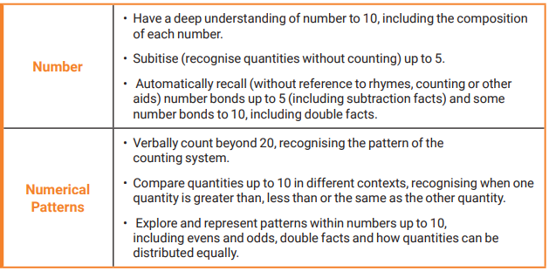


Maths
Have a positive attitude
Use maths vocabulary
Support with number formation and recognition
Count anything and everything!
Play games!

Slide 8
Reception baseline assessment
The RBA is a short, interactive and practical assessment of your child’s early literacy, communication, language and mathematics skills when they begin school, using materials that most children of your child’s age will be familiar with. It became statutory for all schools from September 2021.
What does the RBA mean for my child?
The RBA is not about judging or labelling your child or putting them under any pressure. Your child cannot ‘pass’ or ‘fail’ the assessment. Its main purpose is to create a starting point to measure the progress schools make with their pupils.

Slide 9

PE
Children will have PE lessons every week. Children must come to school wearing their PE kit on these days.
When the weather allows, this will be outside so please ensure the children have warm layers as it gets colder.
Plain navy or black shorts
Plain Yellow or white T-Shirt
(With or without school Logo)
Trainers – ideally slip on or velcro
Plain Black or navy tracksuit (no logos)
(jogging bottoms and jumper)
Earrings must be removed or covered by tape. Studs only.
Long hair must be tied back at all times.
Kingfishers – Tuesday
Robins - Wednesday

Slide 10
Lunches, snacks and drinks
Free daily hot meal at school. We have a three-week rotating menu including two vegetarian options. These options can be found on the weekly newsletter and are ordered daily by the children.
We also have free fruit which is provided daily,
We have free daily milk for children up to the age of 5. Once they have turned 5, this can be purchased through the Cool Milk company.
NAMED water bottle to be brought in daily.

Slide 11




Packed lunches
Balanced and healthy (not too much)
No nut products
(including peanut butter and Nutella)
No chocolate bars and sweets
Pots children can open independently

Slide 12
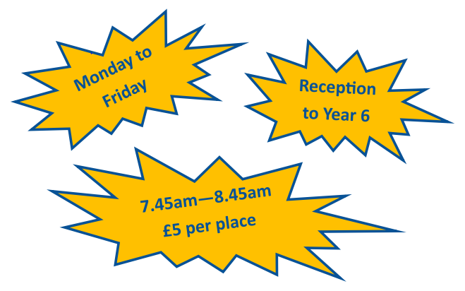
Breakfast club
Email: breakfastclub@wat.cambrianlt.org
To book a place on a one-off or ongoing basis.

Slide 13

Uniform
School Uniform:
Blue sweatshirt/cardigan with or without the school logo
White or blue polo shirt
Grey trousers or shorts
Grey skirt / pinafore dress / culottes (knee or below)
Blue and white gingham dress for (late spring/summer)
Plain white / black / Grey socks
Black shoes/closed-toe sandals – ideally slip on or Velcro
(not trainers)
PLEASE ENSURE ALL CLOTHING IS LABELLED

Slide 14
What your child should bring
A named water bottle
A named book bag
A small named bag which includes a spare change of clothes (this can be left at school on their peg)
Weather permitting items:
A named raincoat
Named hat, scarf, gloves

Slide 15
Trips
We will be planning a trip based on our paws, claws and whiskers topic in Term 6. ​
The trip will cost approximately £15-£20 depending on coach costs. ​
More information will be available nearer the time.

Slide 16
Your support
Thank you for all the help and support you have already given in preparing your child for their year in Reception.
Please continue to support your child to independently:
put on and take off their jumpers and coats (including zips)
use the toilet and wash their hands
use a knife and fork when eating hot food

Slide 17
Your support
We want to build a strong relationship between home and school. Please help us to support your child to thrive by:
Talking – about anything and everything!
Reading – sharing books every day provides quality time, improves your child's love of words and books, develops spoken language and vocabulary, and ignites a passion for their own stories and writing
Maths – look for opportunities to count, name shapes, sing nursery rhymes with numbers and counting, and know left and right
Communication – please check all the channels of communication we have at school: Class Dojo, emails from the office and old-fashioned letters in the book bag! Please let us know if anyone different is collecting your child. If they are not already on the approved pick-up list, we will need confirmation prior to collection
Readiness – please help your child to have the correct equipment for each day (book bag, water bottle, reading books when issued, and wearing PE kit on PE days)

Slide 18
Attendance/Absence
If your child is going to be absent from school, you must ensure you have made contact with the school office before 9am. This can be by email or telephone. Absence@wat.cambrianlt.org
If we do not hear from a family, we will follow this up as it is our duty to safeguard every child.
We monitor attendance on a half termly basis and send letters to parents where attendance is a concern. This is a supportive approach, and we will always listen and offer advice and support where possible.
Notes:
Turning up on time –
5 mins late every day - 3.4 school days
10 minutes late – 6.9 days per year
15 minutes late – 10.3 days per year
20 minutes late – 13.8 days per year
Importance of being in school every day – miss new learning

Slide 19
Administering medicine and any medical needs
Mrs Willison and Mrs Talbot can discuss any concerns or worries you may have regarding any medical needs and, if needed, liaise with the School Nurse and put an individual health care plan in place.
Prescription medicines will only be administered at school where we have parents’ written consent via the Medication Consent Form and are in date, labelled and provided in the original container, as dispensed by the pharmacist, and include instructions for administration, dosage, and storage.
When medication is given, it is recorded on the Record of Medication Administration form at school.

Slide 20
Important dates for this term
Tues 15th or Thurs 17th October | Parents Evenings
Fri 18th October | Individual school photographs
Fri 25th October | School INSET day – school closed to children
Mon 28th October | Autumn Half Term
Mon 4th November | School INSET day – school closed to children
Tues 5th November | Return to school

Slide 21
Thank you for coming. we are looking forward to a great year together!
Please feel free to catch us with any questions.

