Slide 1

Times Tables

Slide 2
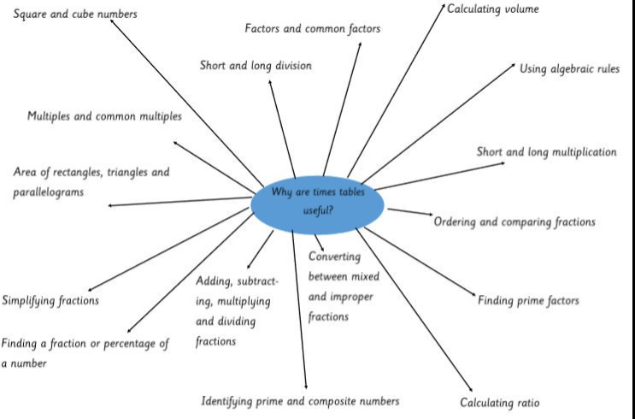
Why do we teach times tables?

Slide 3
What are the expectations?
Year 2 – 2,5 and 10s
Year 3 – 3,4, and 8s
Year 4 – All tables up to 12 x 12

Slide 4

What are the expectations for the Multiplication tables Check?
25 Questions
6 seconds a question

Slide 5
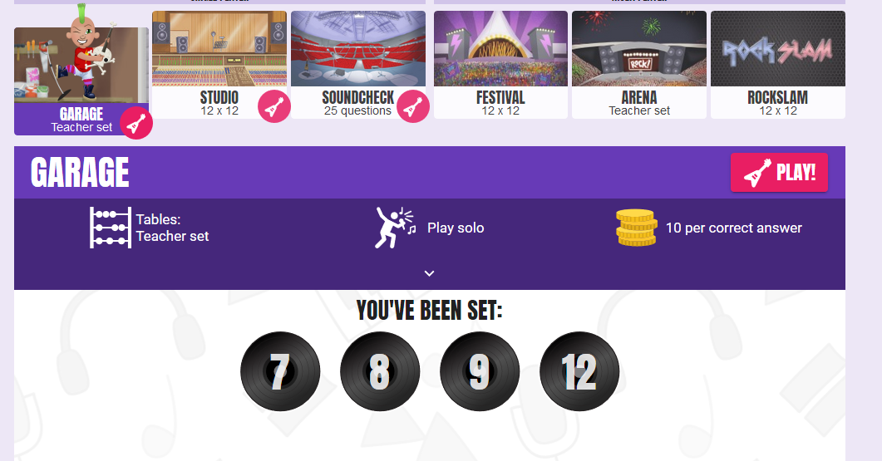
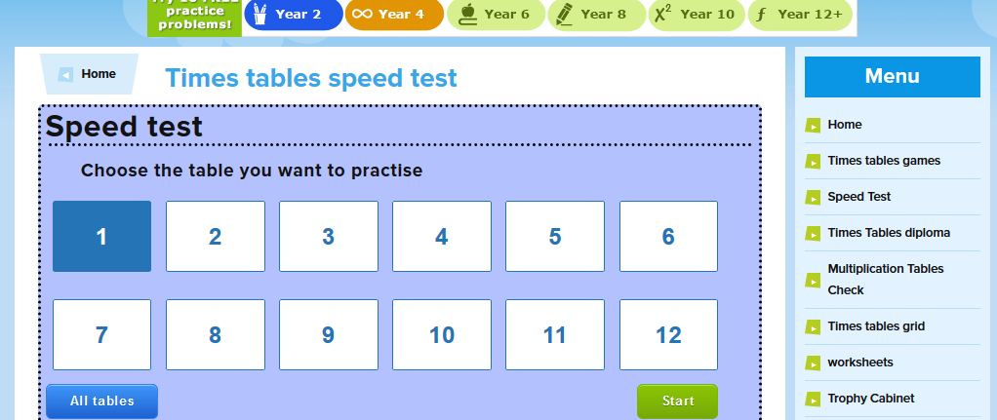
https://www.timestables.co.uk/speed-test/

Slide 6
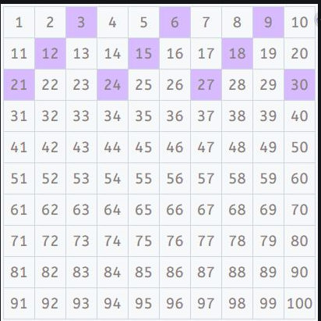
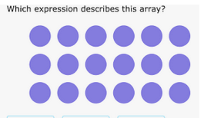
How do we teach times tables?
Arrays
Key facts (x2, x10 and x5)
Commutative Law (6x3 or 3x6)
Counting in step (hundred square to support)
Rote learning

Slide 7
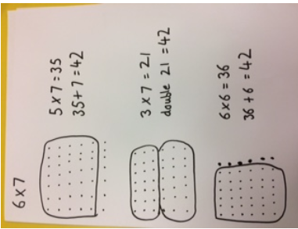
Key facts

Slide 8
18 ÷ 3 =

Slide 9
How can parents support at home?
Little and often
Counting in steps
Times Tables Rockstars
Interactive games
Games

Slide 10

Fingers

Slide 11

Kaboom!

Slide 12
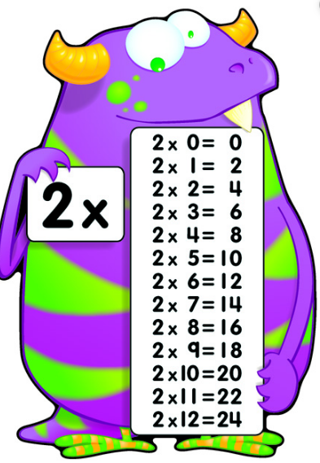
Multiplication Monsters

Slide 13

MultiPIGation

